Slide 1

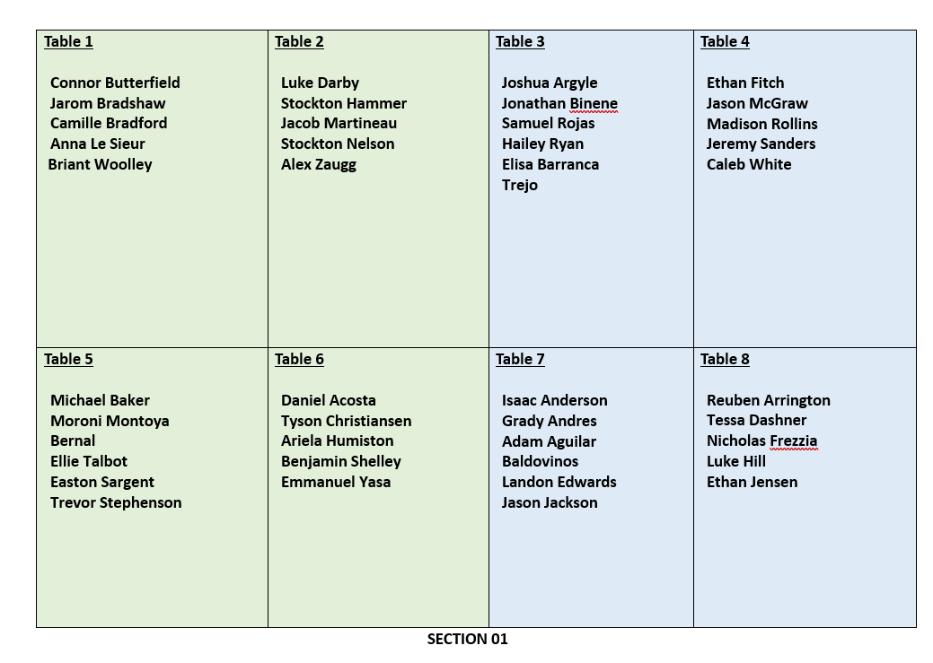


Slide 2
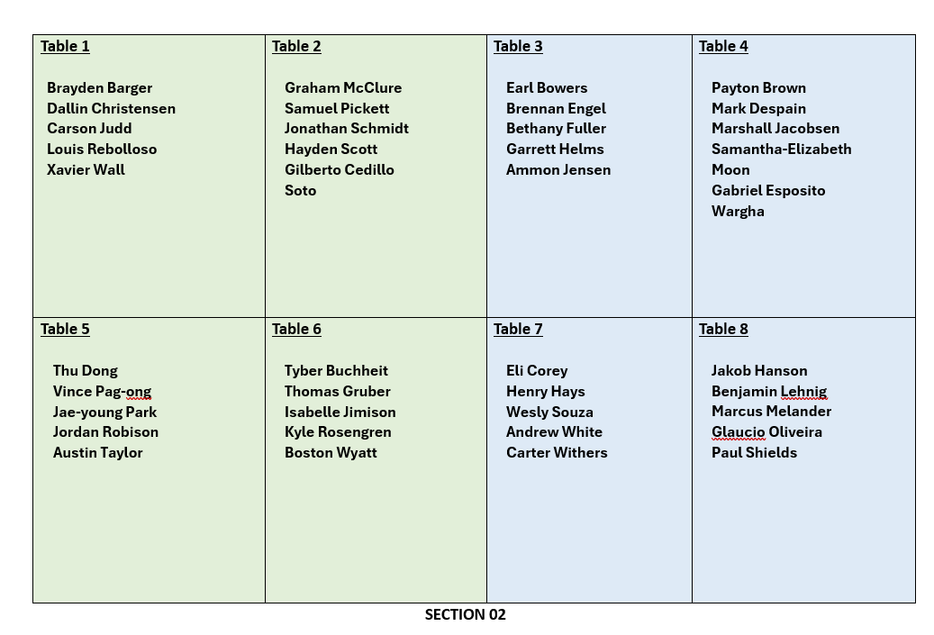

Slide 3
CSE 170 Technical Teamwork Spring 2024
Teamwork Overview

Slide 4
Opening Prayer

Slide 5
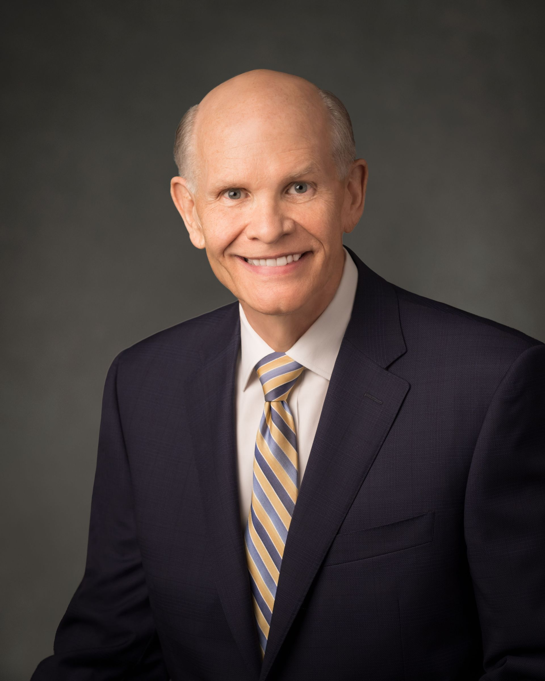
Spiritual Thought
As you walk the covenant path, from baptism to the temple and throughout life, I promise you power to go against the natural worldly flow—power to learn, power to repent and be sanctified, and power to find hope, comfort, and even joy as you face life’s challenges.
Dale G. Renlund – Accessing God’s Power through Covenants – Apr. 2023

Slide 6
Agenda
Emotional Intelligence - Review
U01 Prepare:
A Steady Upward Course
Teamwork: The Most Vital 'Soft Skill'?
Are you an ideal team player? | Patrick Lencioni | TEDxUniversityofNevada
U01 Prove: Self Assessment

Slide 7

Introductions
Take a minute and introduce yourself to the other students at your table.
What is your name?
Where are you from?
What is your major?
What do you do outside of school?

Slide 8
Steady Upward Course Quotes
Each team has a quote about change, frugality or leadership from “A Steady Upward Course”
Discuss the quote and the question as a group for a few minutes.
Choose a spokesperson from your group. The spokesperson will summarize what you discussed.

Slide 9
Change
First, change is part of life. For instance, growing up and growing older are adventures in change filled with uncertainties and surprises. And second, God, through prophets, prepared us to expect changes to accelerate in the world.
We will live for better or for worse with rapid change and the uncertainty it brings. You and I want to make that change work for the better for us and not for the worse.
Each of us can follow the example we have seen here. We can follow a steady upward course in a world of change without fear, welcoming the opportunities
Why is it important to learn to expect and adapt to change in our careers?

Slide 10
Frugality
The expectation is clearly that inspired and frugal people will find ways to bless more students at ever lower cost per student. That has been true at some times in the past. It will be true in the future, whatever the turbulent times ahead will bring.
You can imagine the joy of an employer or a Church leader when such a graduate arrives. The graduates will be at personal peace by having kept the commandments. They will be natural leaders who know how to teach and how to learn. They will have the power to innovate and improve without requiring more of what money can buy. Those graduates of BYU-Idaho will become—and this is a prophesy that I am prepared to make and make solemnly—those graduates of BYU-Idaho will become legendary for their capacity to build the people around them and to add value wherever they serve.
How does learning to do “more with less” benefit the organizations where we will work?

Slide 11
Leadership
The students will learn from example how to keep on a steady upward course in times of great change. They will see leaders and teachers and staff members for whom the Savior and His kingdom are at the center of their lives.
I’ll make you a prophesy. I will simply tell you: The day will come that that capacity to influence people around you for good will have you singled out as one of the great leaders in whatever place you’re in. They will not quite know why, but you will know that the reason you are being singled out is not because of your innate gifts as a leader but because you have done what the Savior would do—learned how to, and did, reach out to those around you to try to lift them, to help them to be better even when it might be a little bit difficult and you might not have been received very well.
Why do strong and principled leaders make the best employees?

Slide 12
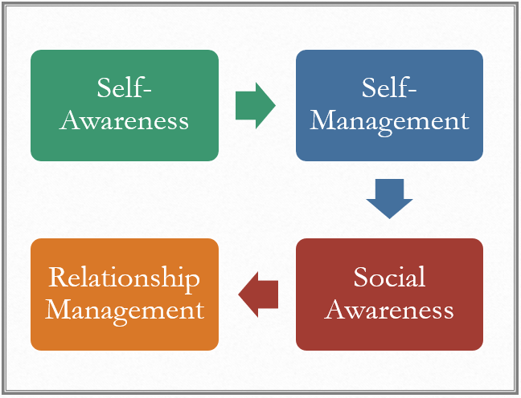
Teamwork: The Most Vital ‘Soft Skill’?
Teams are more interconnected than ever.
Technology spans multiple departments, requiring better teamwork.
We use managed services from other vendors more than ever
Learning to set expectations and manage third-party relationships is key
These days, you must prove that you know how to solve a complex problem by
coordinating with others
following up properly
managing your time
reading between the lines.

Slide 13
Are you an ideal team player?
Humility – willing to learn
Hungry – Strong Work Ethic
Smart – Emotionally Intelligent

Slide 14
Non-Ideal Team Players Which one are you?
Accidental Mess Makers
Humility + Hungry, not Smart
Loveable Slacker
Humility + Smart, not Hungry
Skillful Politician
Smart + Hungry, not Humble

Slide 15
Improving as a Team Player
Ask for feedback from trusted individuals and incorporate this in your life.
Learn to give this feedback to those around you who need it.
We’ll discuss this again later in the semester.

Slide 16
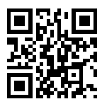
Self Assessment
This self-assessment uses a Likert scale to assess your attitudes about 6 areas of emotional intelligence.
Self-Awareness
Self-Discipline
Social Awareness
Relationship Management
Organizational Awareness
Organizational Management
Don’t over think the questions. Go with your gut reaction to each question.
https://tinyurl.com/28e7jnz4

Slide 17

Next Time
Self-Awareness
Team Formation End of Week 2

